Slide 1
Supervised Learning Capstone: Lending club loan data
Dane Hooker

Slide 2
Data exploration

Slide 3
Data exploration
Data comes from Lending Club, and online peer-to-peer lending platform
1,048,575 rows and 145 columns
71 columns are floats, 38 are integers, and 36 are objects/strings

Slide 4
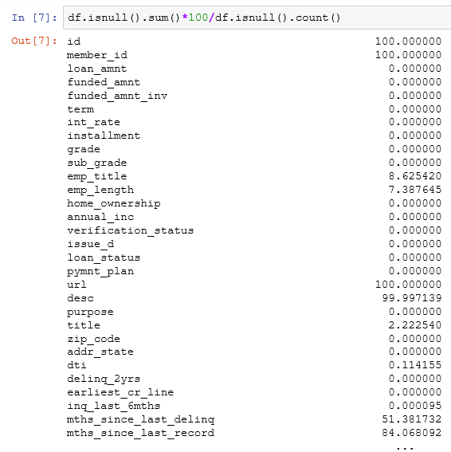
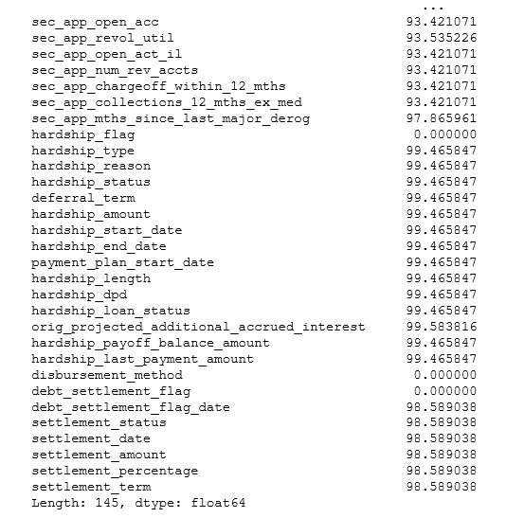
Data exploration

Slide 5
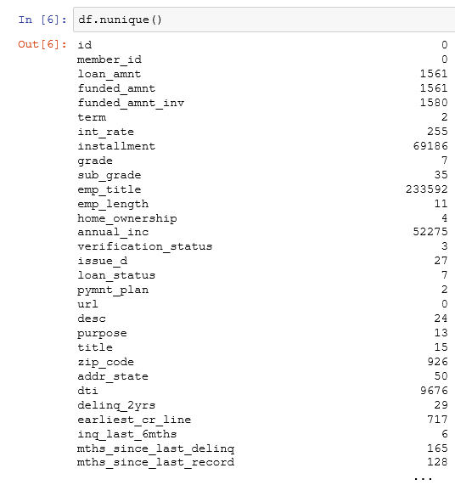
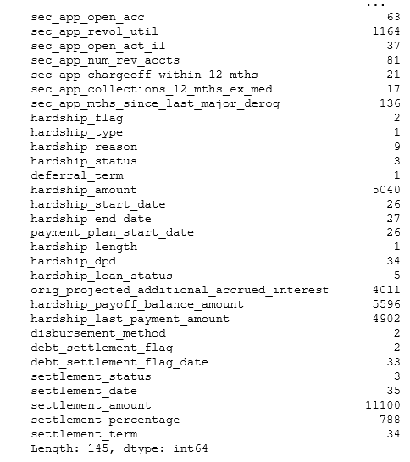
Data exploration

Slide 6
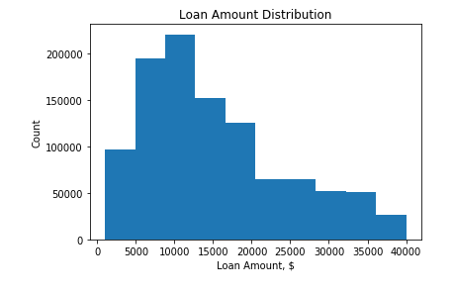
Data exploration

Slide 7
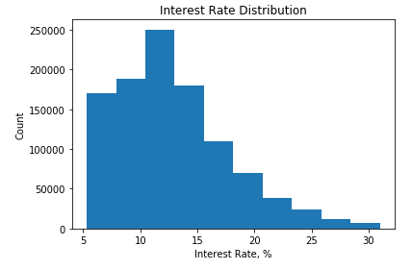
Data exploration

Slide 8
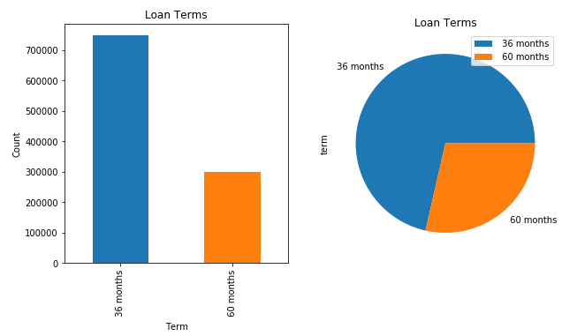
Data exploration

Slide 9
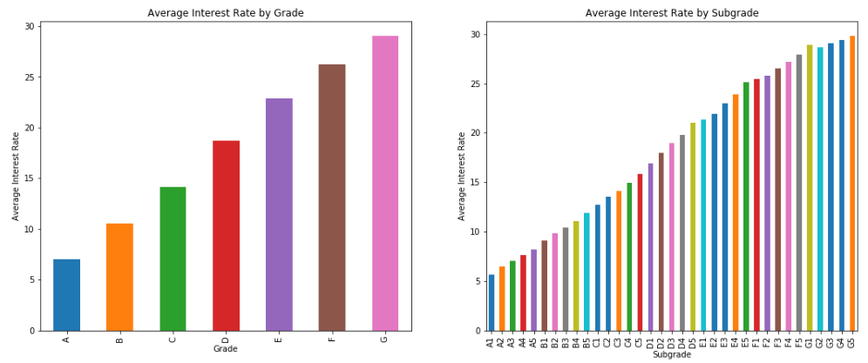
Data exploration

Slide 10
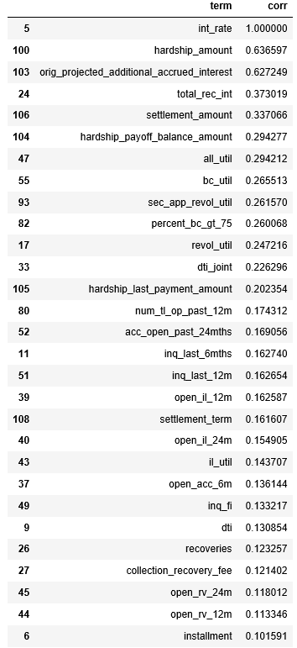
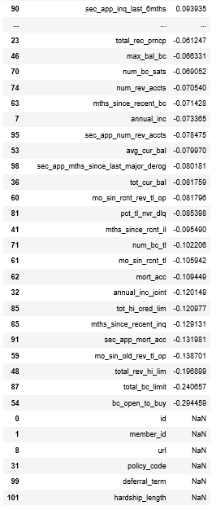
Data exploration

Slide 11
Research question

Slide 12
Research question
What should be the interest rate of a loan, given all the characteristics of the borrower and the loan?
Will not use any data received after loan issuance
Goal: use as an investment tool
If model interest rate = offered rate, the loan is fairly valued
If model interest rate < offered rate, the loan is overvalued and not a good investment
If model interest rate > offered rate, the loan is undervalued and investment is recommended

Slide 13
Data cleaning & model preparation

Slide 14
Data cleaning & model preparation
Taking two parallel approaches to feature selection
Manual approach
Bulk approach with PCA
Run models on each feature set
Weigh accuracy vs. computational intensity

Slide 15
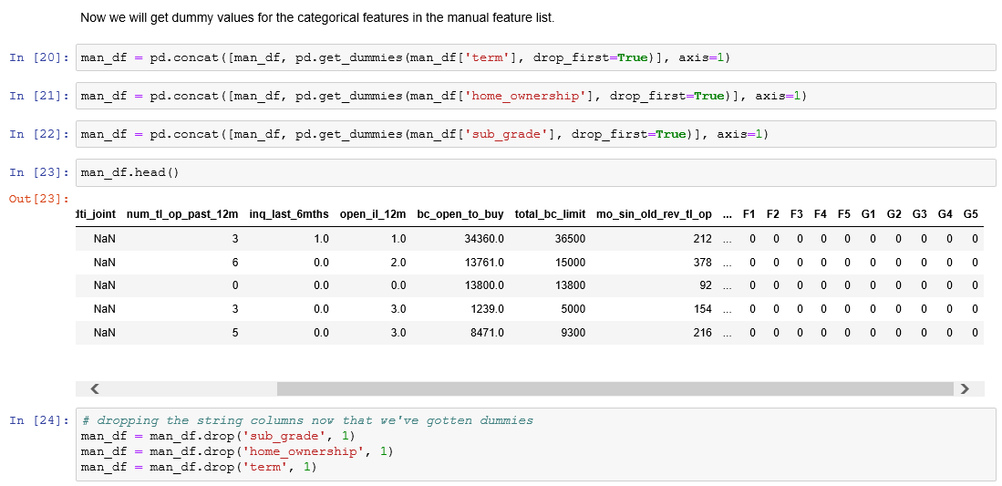
Data cleaning & model preparation

Slide 16
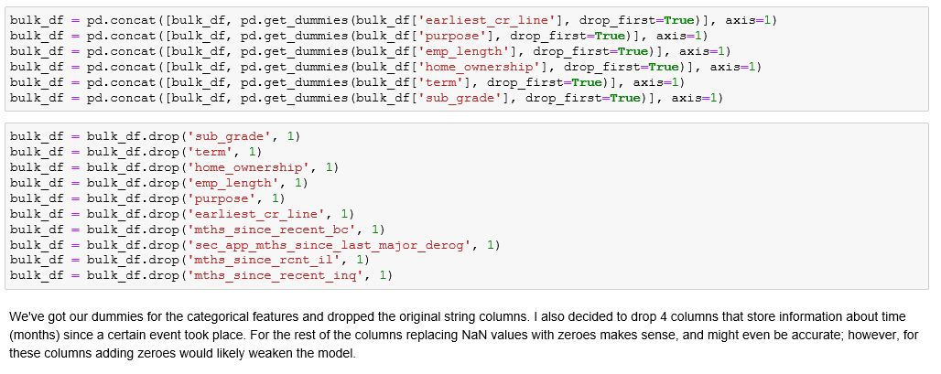
Data cleaning & model preparation

Slide 17
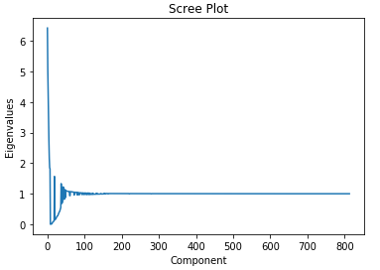
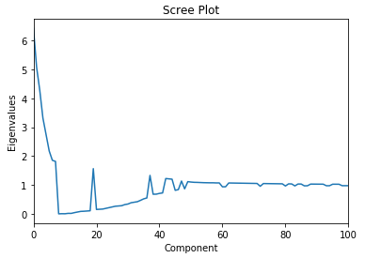
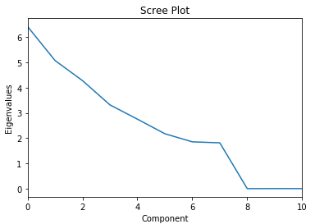
Data cleaning & model preparation

Slide 18
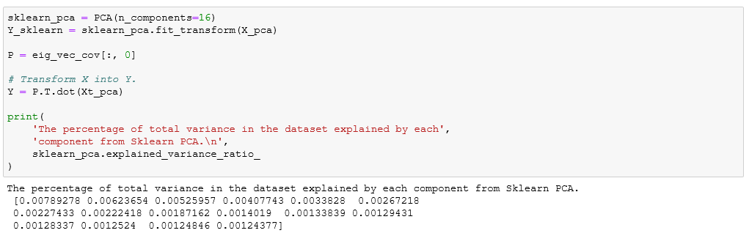
Data cleaning & model preparation

Slide 19
models

Slide 20
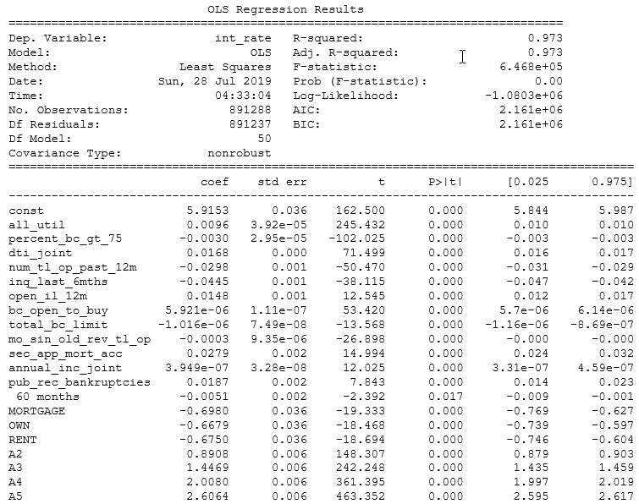
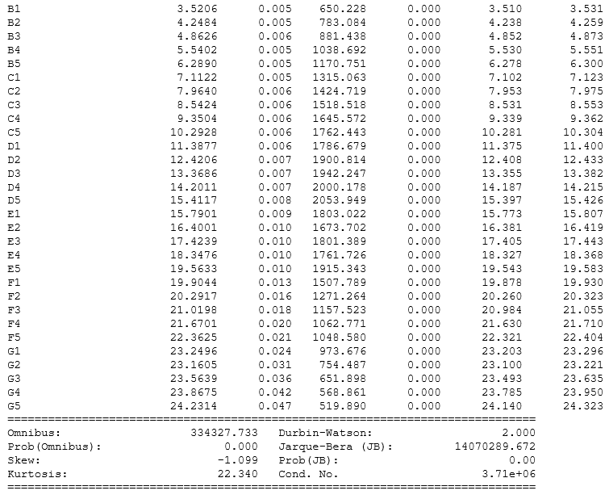
Models- OLS Training

Slide 21
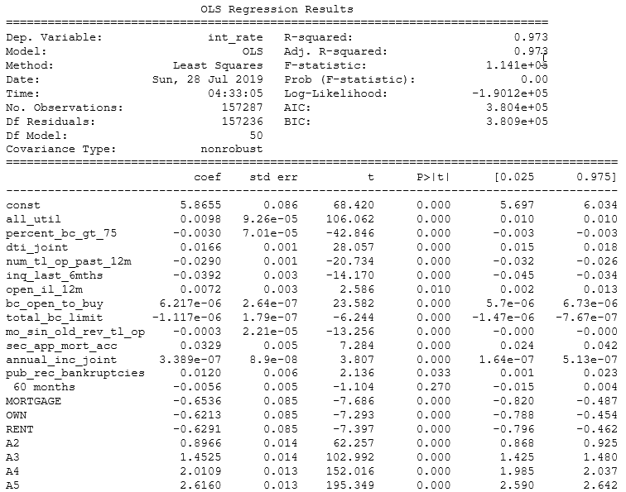
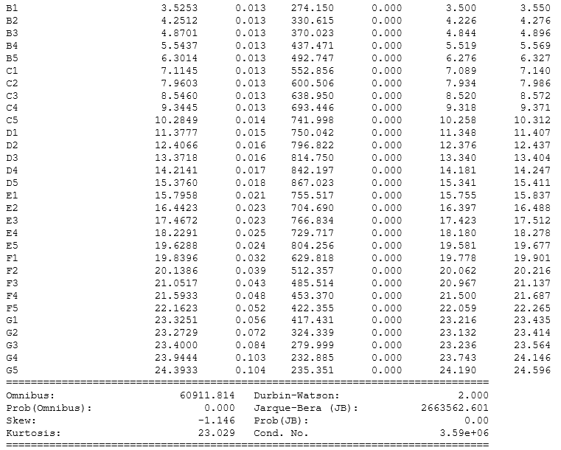
Models- ols test

Slide 22
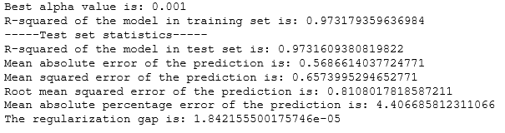
Models- ridge regression

Slide 23
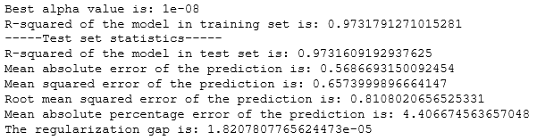
Models- lasso regression

Slide 24

Models- elasticnet regression

Slide 25
Models- Svr & decision forest regression
Both models timed out
These models are more computationally intensive than OLS
Because of timeout and success of other models, decided to abandon

Slide 26
summary

Slide 27
summary
OLS, Ridge, Lasso, and ElasticNet all had R² = .973
Regularization gap essentially non-existent
Strong, almost identical performance likely due to the exhaustive nature of the data set
Choose OLS as model of choice for simplicity

